Slide 1


Notes:
Images:
https://miro.medium.com/max/962/1*cxfqR8NAj8HGal8CVOZ7hg.png
https://miro.medium.com/max/1400/1*V0a5jxOmbBfQlKhtShKwfA.jpeg

Slide 2

Pandas: An animal? Data Analysis?
Pandas is an
open source, BSD-licensed library
provides high-performance, easy-to-use data structures and data analysis tools for the Python programming language.
It has functions for analyzing, cleaning, exploring, and manipulating data.
Wes McKinney started building what would become pandas at AQR Capital while he was a researcher there from 2007 to 2010
The name is derived from the term "panel data", an econometrics term for data sets that include observations over multiple time periods for the same individuals.
Its name is a play on the phrase "Python data analysis" itself.
Notes:
Image:
https://12ax7web.s3.amazonaws.com/accounts/1/products/1986199880787/Sad-Panda_800x800_SEPS-1000x1000.jpg

Slide 3

Why?
Great for five typical steps in the processing and analysis of data, regardless of the origin of data
load,
prepare,
manipulate,
model, and
analyze.

Slide 4
Why?
We can
analyze big data and make conclusions based on statistical theories.
clean messy data sets and make them readable and relevant.
one of the most preferred tools for data scientists
next to matplotlib for data visualization and
NumPy, the fundamental library for scientific computing in Python on which Pandas was built.

Slide 5

What is it used for?
What is the average of some data?
Who has the highest/lower values?
What about the outliers?
Is there a correlation between this and that?
How can I use the data to make better decisions?
Is my data clean?
This Photo by Unknown Author is licensed under CC BY-SA-NC

Slide 6

Getting started
https://pandas.pydata.org/docs/getting_started/index.html#getting-started
Already installed?
import pandas
If not installed: https://pandas.pydata.org/docs/getting_started/install.html
pip install pandas
Or use Anaconda
conda install pandas

Slide 7
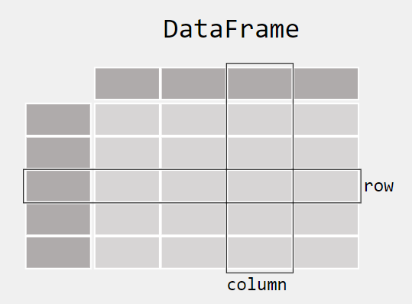
Data in pandas
When working with tabular data, such as data stored in spreadsheets or databases, pandas is the right tool for you.
pandas will help you to explore, clean, and process your data.
In pandas, a data table is called a DataFrame.
DataFrame is a two-dimensional array with heterogeneous data.
Columns have labels.
Rows have index values by default starting from 0(zero), but you can change it.

Slide 8

Basic operations
Create DataFrame from lists, dictionaries with and without index
Read data from various resources (csv, excel, etc.)
shape: Dimensions of the DataFrame (rows x columns)
head(): Access top 5 elements
head(n): Access top n elements
tail(): Access last 5 elements
tail(n): Access last n elements
This Photo by Unknown Author is licensed under CC BY-SA

Slide 9
Basic operations
columns: Access all column names
DataFrame[“columnname”]: Access data of one column
DataFrame[[“columnname”, “columnname2”, …] ]: Access data of multiple columns
read_csv(file_name): Reads data from a csv file (other formats are available)
describe(): Descriptive statistics
info(): Information about the DataFrame
loc(index): Returns the row or rows by index or index label
iloc(index): Returns the row or rows by index
This Photo by Unknown Author is licensed under CC BY-SA

Slide 10
Basic operations
max(): Max of all values
min(): Min of all values
mean(): Mean of all values
median(): Median of all values
mode(): Mode of all values
sum(): Sum of the values
Filtering
Adding/Deleting
Sorting
This Photo by Unknown Author is licensed under CC BY-SA

Slide 11
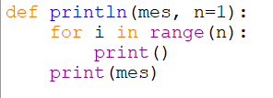
Auxilary function
println function is used for printing n newlines before printing the message.
Default is 1 blank line
Notes:
def println(mes, n=1):
for i in range(n):
print()
print(mes)

Slide 12
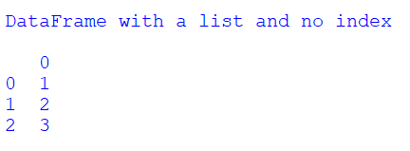
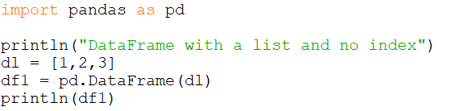
Examples
First import pandas (generally imported as pd)
Then create a DataFrame from a list and no index
Notes:
import pandas as pd
println("DataFrame with a list and no index")
dl = [1,2,3]
df1 = pd.DataFrame(dl)
println(df1)

Slide 13
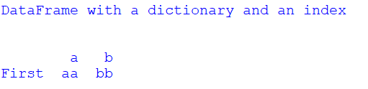
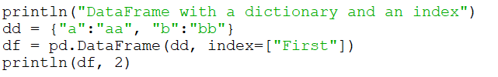
Examples
DataFrame with a dictionary and an index
Notes:
println("DataFrame with a dictionary and an index")
dd = {"a":"aa", "b":"bb"}
df = pd.DataFrame(dd, index=["First"])
println(df, 2)

Slide 14
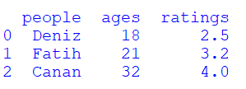
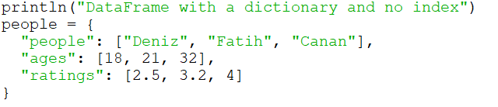
Examples
DataFrame with a dictionary and no index
Notes:
println("DataFrame with a dictionary and no index")
people = {
"people": ["Deniz", "Fatih", "Canan"],
"ages": [18, 21, 32],
"ratings": [2.5, 3.2, 4]
}

Slide 15
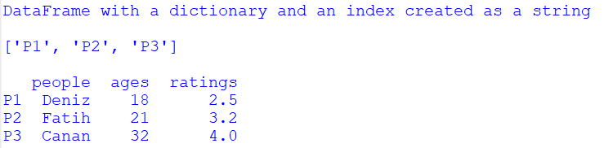
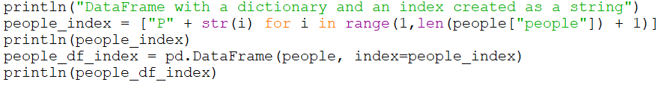
Examples
DataFrame with a dictionary and an index created as a string
Notes:
println("DataFrame with a dictionary and an index created as a string")
people_index = ["P" + str(i) for i in range(1,len(people["people"]) + 1)]
println(people_index)
people_df_index = pd.DataFrame(people, index=people_index)
println(people_df_index)

Slide 16
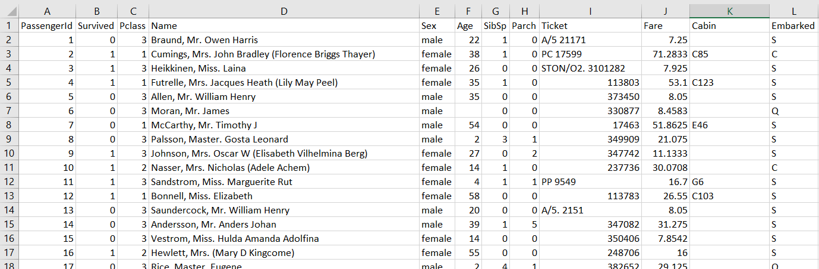
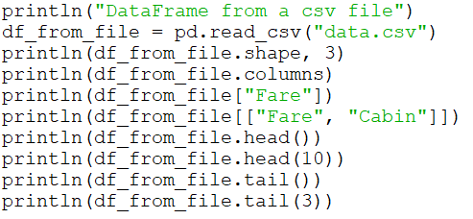

Examples
DataFrame from a csv file
Source: https://s3.amazonaws.com/thinkific/file_uploads/118220/attachments/f60/fba/4d6/data.zip
Notes:
println("DataFrame from a csv file")
df_from_file = pd.read_csv("data.csv")
println(df_from_file.shape, 3)
println(df_from_file.columns)
println(df_from_file["Fare"])
println(df_from_file[["Fare", "Cabin"]])
println(df_from_file.head())
println(df_from_file.head(10))
println(df_from_file.tail())
println(df_from_file.tail(3))

Slide 17
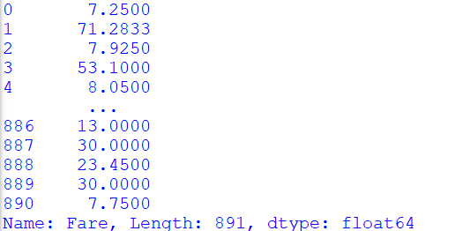
Examples
DataFrame from a csv file
Source: https://s3.amazonaws.com/thinkific/file_uploads/118220/attachments/f60/fba/4d6/data.zip
Notes:
println("DataFrame from a csv file")
df_from_file = pd.read_csv("data.csv")
println(df_from_file.shape, 3)
println(df_from_file.columns)
println(df_from_file["Fare"])
println(df_from_file[["Fare", "Cabin"]])
println(df_from_file.head())
println(df_from_file.head(10))
println(df_from_file.tail())
println(df_from_file.tail(3))

Slide 18
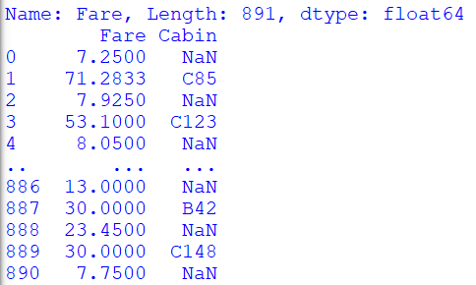
Examples
DataFrame from a csv file
Source: https://s3.amazonaws.com/thinkific/file_uploads/118220/attachments/f60/fba/4d6/data.zip
Notes:
println("DataFrame from a csv file")
df_from_file = pd.read_csv("data.csv")
println(df_from_file.shape, 3)
println(df_from_file.columns)
println(df_from_file["Fare"])
println(df_from_file[["Fare", "Cabin"]])
println(df_from_file.head())
println(df_from_file.head(10))
println(df_from_file.tail())
println(df_from_file.tail(3))

Slide 19
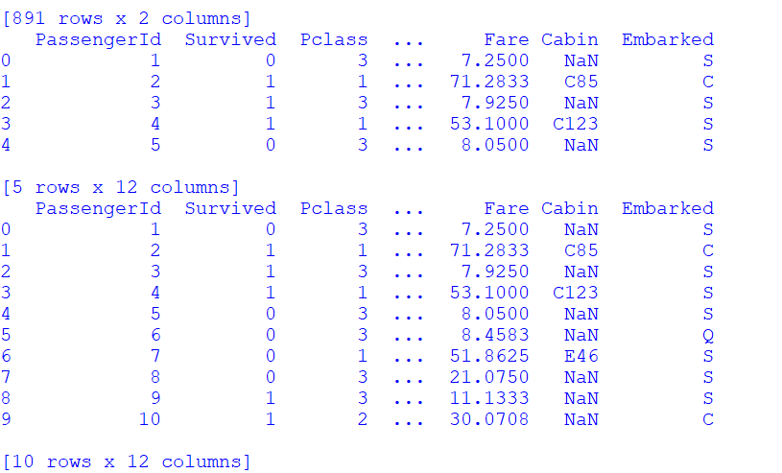
Examples
DataFrame from a csv file
Source: https://s3.amazonaws.com/thinkific/file_uploads/118220/attachments/f60/fba/4d6/data.zip
Notes:
println("DataFrame from a csv file")
df_from_file = pd.read_csv("data.csv")
println(df_from_file.shape, 3)
println(df_from_file.columns)
println(df_from_file["Fare"])
println(df_from_file[["Fare", "Cabin"]])
println(df_from_file.head())
println(df_from_file.head(10))
println(df_from_file.tail())
println(df_from_file.tail(3))

Slide 20
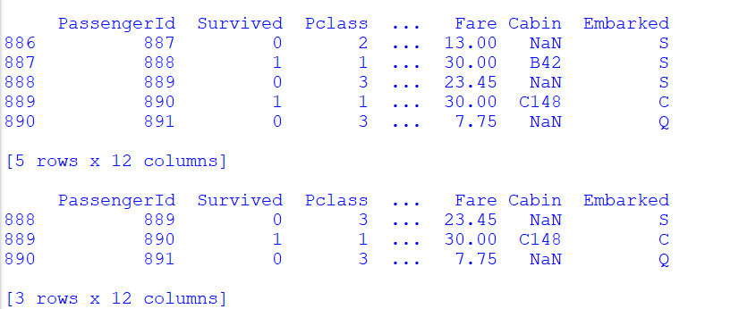
Examples
DataFrame from a csv file
Source: https://s3.amazonaws.com/thinkific/file_uploads/118220/attachments/f60/fba/4d6/data.zip
Notes:
println("DataFrame from a csv file")
df_from_file = pd.read_csv("data.csv")
println(df_from_file.shape, 3)
println(df_from_file.columns)
println(df_from_file["Fare"])
println(df_from_file[["Fare", "Cabin"]])
println(df_from_file.head())
println(df_from_file.head(10))
println(df_from_file.tail())
println(df_from_file.tail(3))

Slide 21
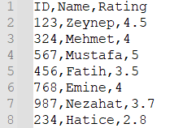
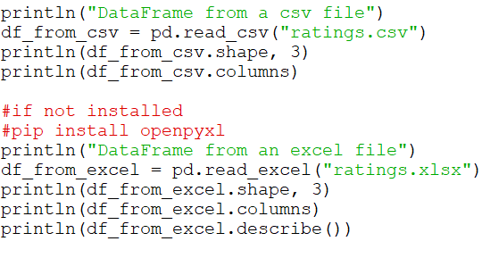
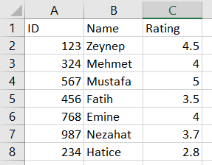
Read from Excel
It is possible to read from many data sources including Excel.
ratings.csv
ratings.xlsx
Notes:
println("DataFrame from a csv file")
df_from_csv = pd.read_csv("ratings.csv")
println(df_from_csv.shape, 3)
println(df_from_csv.columns)
#if not installed
#pip install openpyxl
println("DataFrame from an excel file")
df_from_excel = pd.read_excel("ratings.xlsx")
println(df_from_excel.shape, 3)
println(df_from_excel.columns)
println(df_from_excel.describe())

Slide 22

Quiz: Test yourself
How can I learn the column names of a DataFrame?
How can I find the number of rows in a DataFrame?
How can I find the number of columns in a DataFrame?
How can I display the first 5 rows in a DataFrame?
How can I display the first 6 rows in a DataFrame?
How can I display the last 3 rows in a DataFrame?
How can I display the last 20 rows in a DataFrame?
How can I display the data of the column whose name is “size” in a DataFrame?
This Photo by Unknown Author is licensed under CC BY

Slide 23
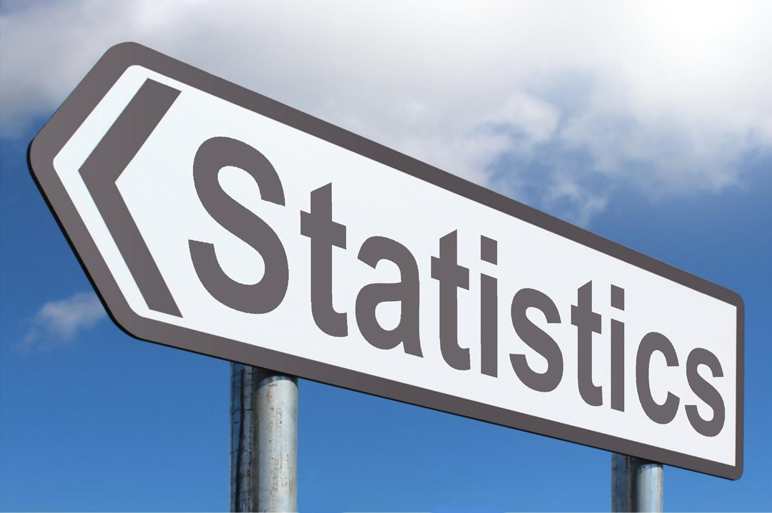
Descriptive statistics
describe(): Generate descriptive statistics.
Descriptive statistics include those that summarize the central tendency, dispersion and shape of a dataset’s distribution, excluding NaN values.
Analyzes both numeric and object series, as well as DataFrame column sets of mixed data types. The output will vary depending on what is provided.
This Photo by Unknown Author is licensed under CC BY-SA

Slide 24

Describe
For numeric data, the result’s index will include
count, mean, std, min, max as well as
lower, 50 and upper percentiles.
the lower percentile is 25 and the upper percentile is 75.
the 50 percentile is the same as the median.
For object data (e.g. strings or timestamps), the result’s index will include
count, unique, top, and freq.
the top is the most common value.
the freq is the most common value’s frequency.
Timestamps also include the first and last items.
This Photo by Unknown Author is licensed under CC BY-SA-NC

Slide 25
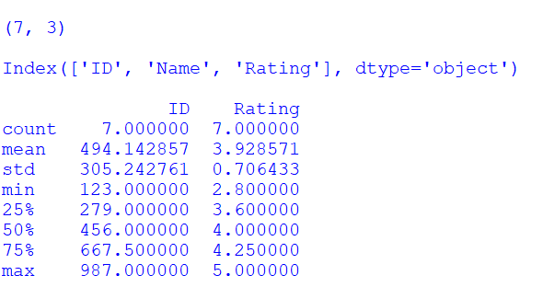
println(df_from_excel.describe())

Slide 26
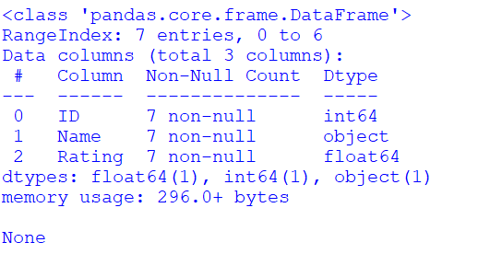
println(df_from_excel.info())

Slide 27
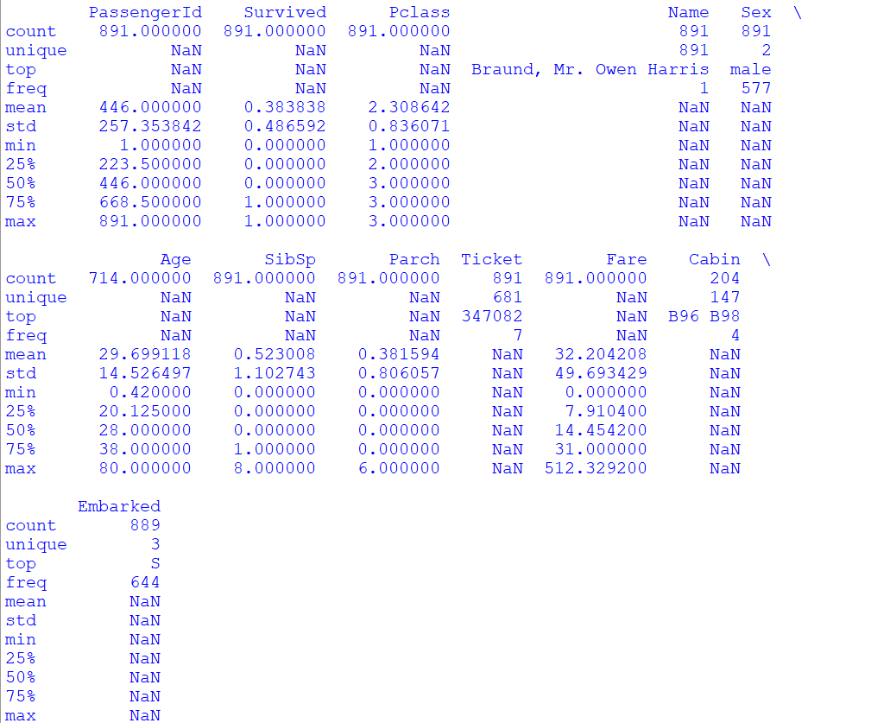
#Display all columns pd.set_option('display.max_columns', None) #Include all columns in the analysis println(df_from_file.describe(include="all"))

Slide 28
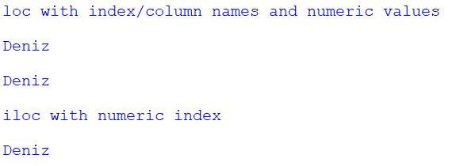
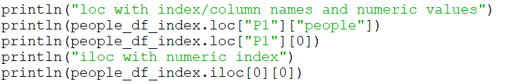
loc vs iloc
Notes:
println("loc with index/column names and numeric values")
println(people_df_index.loc["P1"]["people"])
println(people_df_index.loc["P1"][0])
println("iloc with numeric index")
println(people_df_index.iloc[0][0])

Slide 29
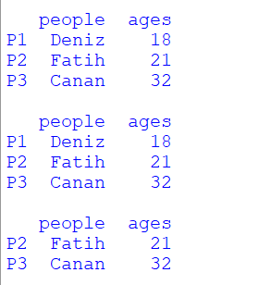
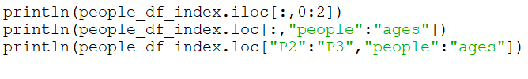
iloc/loc: Select subsets of rows and columns

Slide 30
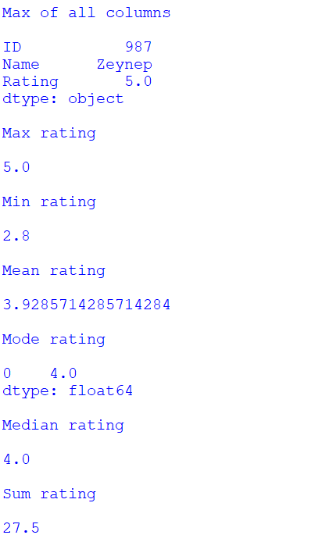
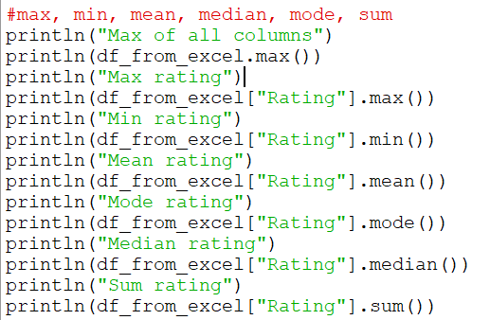
max, min, mean, median, mode, sum

Slide 31
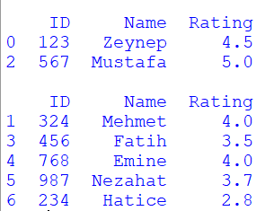
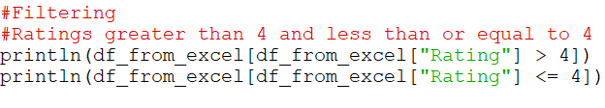
Filtering
Notes:
#Filtering
#Ratings greater than 4 and less than or equal to 4
println(df_from_excel[df_from_excel["Rating"] > 4])
println(df_from_excel[df_from_excel["Rating"] <= 4])

Slide 32
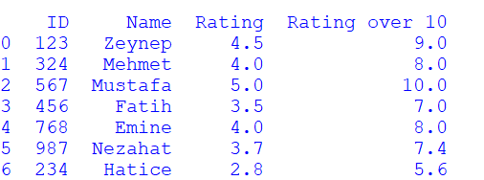

Adding/Deleting

Slide 33
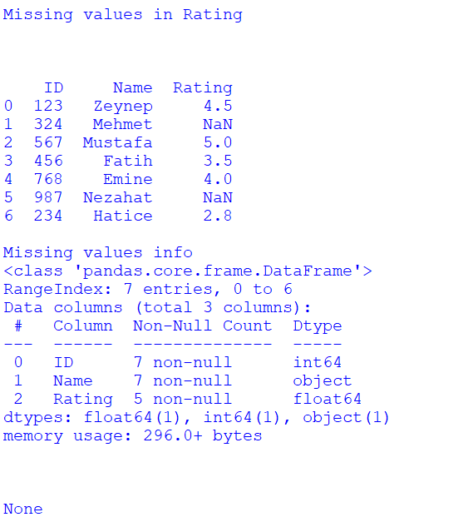
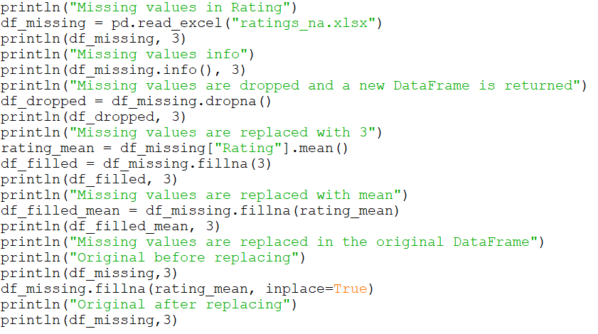
Adding/Deleting

Slide 34
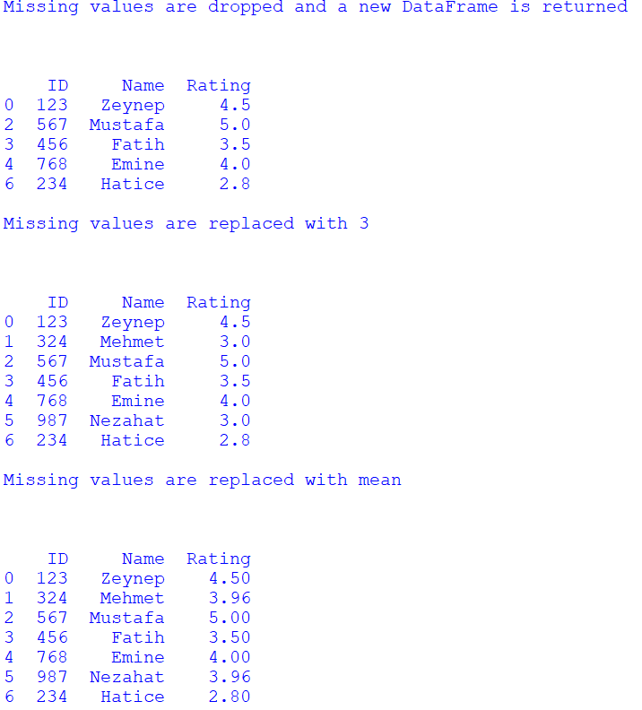
Adding/Deleting

Slide 35
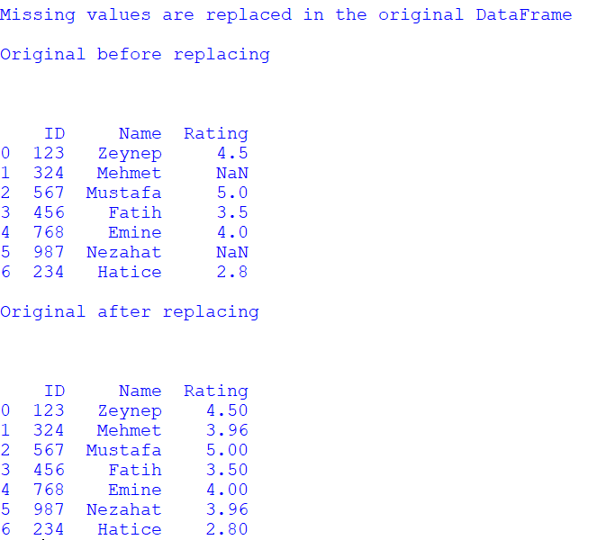
Adding/Deleting

Slide 36
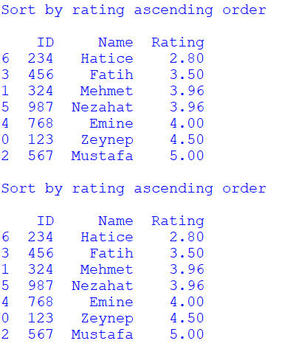
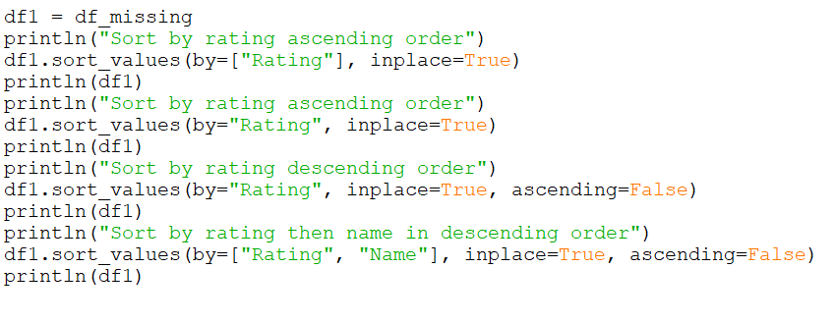
Sorting
Notes:
df1 = df_missing
println("Sort by rating ascending order")
df1.sort_values(by=["Rating"], inplace=True)
println(df1)
println("Sort by rating ascending order")
df1.sort_values(by="Rating", inplace=True)
println(df1)
println("Sort by rating descending order")
df1.sort_values(by="Rating", inplace=True, ascending=False)
println(df1)
println("Sort by rating then name in descending order")
df1.sort_values(by=["Rating", "Name"], inplace=True, ascending=False)
println(df1)

Slide 37
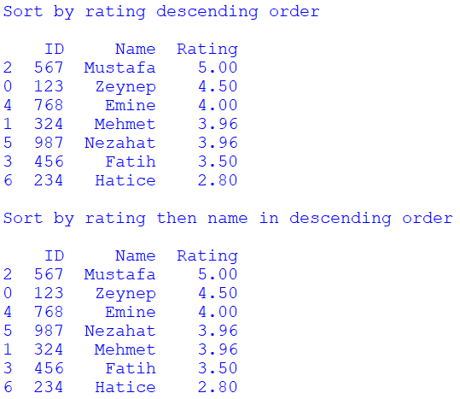
Sorting
Notes:
df1 = df_missing
println("Sort by rating ascending order")
df1.sort_values(by=["Rating"], inplace=True)
println(df1)
println("Sort by rating ascending order")
df1.sort_values(by="Rating", inplace=True)
println(df1)
println("Sort by rating descending order")
df1.sort_values(by="Rating", inplace=True, ascending=False)
println(df1)
println("Sort by rating then name in descending order")
df1.sort_values(by=["Rating", "Name"], inplace=True, ascending=False)
println(df1)

